Slide 1

Bitcoin daily Price Movement predication Using Twitter Sentiment Analysis.
By Faridoon Farahi

Slide 2

Table of Contents
Problem Statement
Bitcoin
Project work-flow
Data Collection and Cleaning
Data Exploration
Modeling
Conclusion and Future work

Slide 3
Problem Statement
This project is aimed at predicting the daily increase or decrease in the price of bitcoin using Twitter sentiment analysis.

Slide 4

Bitcoin’s History
In October 2008, Satoshi Nakamoto created bitcoin.
A transparent ledger without a central authority.
Pseudo-anonymous.
Decentralized.
Buying bitcoin.
Digital commerce
Notes:
In October 2008 a document was published online by a guy calling himself Satoshi Nakamoto. The document also called a whitepaper, suggested a way of creating a system for decentralized currency called bitcoin. This system claimed to create digital money.
This means bitcoin is pseudo-anonymous; everything is open, transparent and trackable but still you cant tell who is sending what to whom.
Finally I believe the most important benefit of the bitcoin is that it opens up digital commerce to all the people around the world especially those who don’t have access to the current banking system. These people are unbanked or underbanked because of where they live and the reality that they have been born into. So today with a mobil phone and a click of a button they can start trading using bitcoin no permission needed. Today there are several companies online and offline that accept bitcoin. Like Microsoft, expedia. There are even bitcoin debit cards that allow you to pay at almost any store with your bitcoin balance. However the road toward acceptance by the majority of the public is still a long one.

Slide 5

Project Work-flow
Tweets Of 70 Influential People
Training Model
Bitcoin Price
Remove Stop words
0
s
s
Learned Model
Calculate Tweets’ Score
Feature Set
1
1
Dictionary SCORES
Label
Classification
* S=0 training and S=1 testing
Notes:
Reason : Vader uses lexicon based approach for sentiment analysis. The words in lexicon are given their “scores/value” based on the polling, i.e. polls were conducted to rate each word and then the average of the ratings were used for each word. This is good for generalized topics, however for context specific topics this approach may not the correct one to use. To elaborate on it, in our tweets we can see bitcoin specific words such as Bitcoin, Blockchain, crypto and bitpay just to name a few. These words are also amongst the top occurring words. However, these words aren’t present in Vader lexicon. Since we want to perform context specific sentiment analysis, therefore we also need a context specific lexicon. Therefore using a data driven approach, a dictionary of scores is created which is then added to Vader to be used for calculating tweet scores.

Slide 6

Data collection and Cleaning
Twitter data for 70 most influential people.
Bitcoin prices (2014-2021) from Yahoo Finance.
Stop words removed.
Cleaned the tweets(Hyperlinks, Hashtags, $, @ etc..).
Notes:
Luckily we can find the list of all the influential people in the world of crpytocurrencies for every year along with their twitter handles on https://cryptoweekly.co/100/.
The official Twitter API is used for download the tweets

Slide 7
Data Exploring and Processing
Sentiment analysis using VaderSentiment
Filtering data for bitcoin specific tweets
Creating bitcoin specific score dictionary
Feature Engineering
Notes:
Reason : Vader uses lexicon-based approach for sentiment analysis. using a data driven approach, a dictionary of scores is created which is then added to Vader to be used for calculating tweet scores.
The words in lexicon are given their “scores/value” based on the polling, i.e. polls were conducted to rate each word and then the average of the ratings were used for each word. This is good for generalized topics, however for context specific topics this approach may not be the correct one to use. To elaborate on it, in our tweets we can see bitcoin specific words such as Bitcoin, Blockchain, crypto and bitpay just to name a few. These words are also amongst the top occurring words. However, these words aren’t present in Vader lexicon. Since we want to perform context specific sentiment analysis, therefore we also need a context specific lexicon. Therefore using a data driven approach, a dictionary of scores is created which is then added to Vader to be used for calculating tweet scores.
Engineered features include taking the price difference from a certain day to previous days in 7-day window. For example, if Tuesday is the day we are considering, then we will calculate the price difference between the closing prices for Tuesday and Monday, Tuesday and Sunday, Tuesday and Saturday and so on to till we calculate the close price difference between Tuesday and last Tuesday (i.e. Tuesday of the last week).

Slide 8
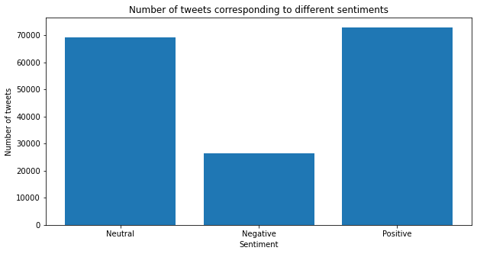

Slide 9
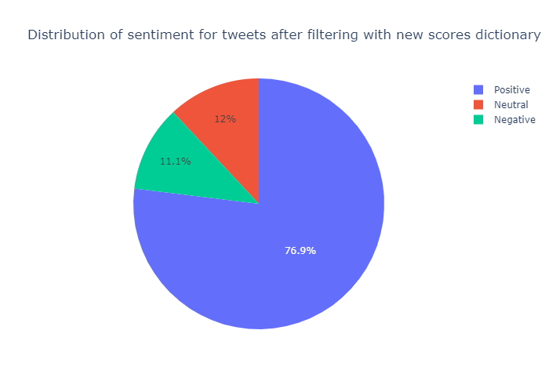

Slide 10
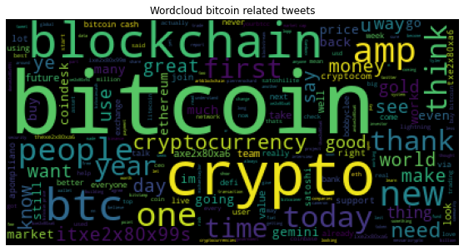

Slide 11
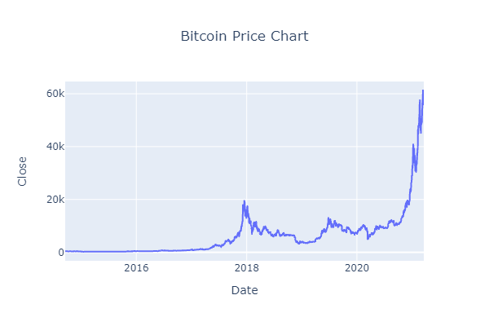

Slide 12
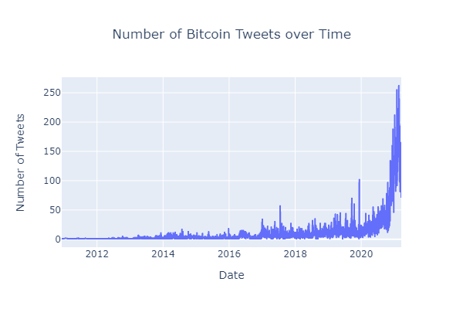

Slide 13
Modeling
2 Approaches are used
Modeling using only sentiment scores.
Modeling using sentiment scores and engineered features.
Models are also trained on scaled and unscaled data
Selected models are sensitive to scale of data.
StandardScalar is used for scaling data.
Notes:
Engineered features include taking the price difference from a certain day to previous days in 7-day window. For example, if Tuesday is the day we are considering, then we will calculate the price difference between the closing prices for Tuesday and Monday, Tuesday and Sunday, Tuesday and Saturday and so on to till we calculate the close price difference between Tuesday and last Tuesday (i.e. Tuesday of the last week).
More then 7-day window could be used but keeping in mind the curse of dimensionality, a 7-day window is used

Slide 14
Classification Algorithms
3 Machine Learning models are used:
Support Vector Machine (SVM)
Logistic Regression
K-Nearest Neighbors
1 Deep Learning algorithm is used :
Multi-layer Perceptron
Notes:
Support Vector Machine is being used since it has a regularization parameter and is good to overcome overfitting. And is very much suited for binary classification. The hyperplane is affected by only the support vectors thus outliers have less impact.
Since the problem is a Binary Classification problem, I chose Logistic Regression as it is a binary classifier and is expected to perform well. Logisitic Regression also has a regularization parameter that can be helpful in preventing overfitting.
3. Lower Dimensionality: KNN is suited for lower dimensional data.
KNN works well with a small number of input variables (p), but struggles when the number of inputs is very large.
4. Finally, I used a Multi-Layer Perceptron Classifier because it is considered suitable for classification predication problems where inputs are assigned a class or label.

Slide 15
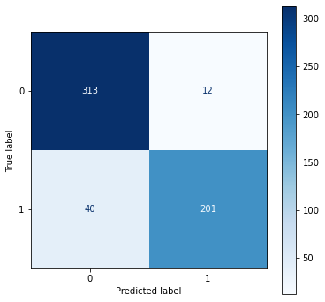
Model Evaluation
Confusion Matrix for Logistic Regression
Evaluation Metric Scores
Accuracy | 90%
Recall | 83%
Precision | 94%
Notes:
We are using other evaluation metrics because accuracy is not a good evaluation metric on its own. It is possible that the model does not learn the minority data and therefore starts acting like a baseline model, i.e. only predicts the majority class which in this case is increase. If that happens, accuracy would be very misleading given the distribution of our data.
Total = 566 samples
Positive = increase
Negative = decrease

Slide 16
Conclusion and Future work
Conclusion
Twitter Sentiment Analysis
Good for finding relationship between tweets and bitcoin price.
70 Bitcoin influencers tweets could be a good source for predicting bitcoin price movement.
K-Nearest Neighbors and Multi-layer Perceptron algorithms can perform well to classify the increase and decrease in bitcoin price.
Future work
Rank the 70 influencers
Find a way to rank each influencer individually to see the degree to which they influence
Thin out the herd so that we have only those who are truly the most influential
Explore other methods of sentiment analysis.
Notes:
Currently, deep learning models such as RNN and LSTM are known for their use in Time series problems but for sentiment analysis

Slide 17

QUESTIONS ?

